Slide 1
Chapter 4
Internal environment Analysis

Slide 2
Internal environment defn
The conditions, entities, events ,and factors with in an organization that influence its activities and choices
concerned with providing management with a detail understanding of current strategies and deployment of resources in support of strategies

Slide 3
Internal env’t Analysis -Definition
Internal analysis is the systematic evaluation of the key internal features of an organization
Understanding of current strategies and deployment of resources in support of strategies
Identify and classify variables within an organization as the strength and weakness of a firm
The process by w/c strategist examine the firm’s marketing and distribution, R&D, production and operations ,corporate resources and personnel , and finance ,information technology and general management factor where the firm has significant strengths and weakness

Slide 4
Purpose of Analysis of internal Environment
To identify resources, competencies, core competences, to be developed and exploited
To evaluate how effectively value adding (input-process-output)activities are organized
To evaluate the performance of the products
To evaluate the financial performance
To evaluate investment potential
To evaluate the marketing and distribution channel
To evaluate the role of R&D and engineering factor
To evaluate the product performance

Slide 5
Steps in organization Analysis
Identify internal factors
Identify all the crucial factors responsible for the success of an organization
Select certain critical factors that assist to the achievement of corporate objectives that could easily be found in functional areas of management
Determine the importance of the factor
decide/determine the relative importance of these factor
Some of the strength is more important than others b/c they contribute more
Some internal weakness can provide dangerous ,while others are a little consequences

Slide 6
3. Determine strength and weakness
Strength is an inherent capacity which an organization can use to gain strategic advantage
Weakness inherent limitation or constraint which creates a strategic disadvantage for an organization
4. Prepare strategic advantage profile
Prepare a strategic advantage profile and organizational capability profile for the firm and compare with it with profile of successful competitors to develop a pattern of the firms strength and weakness

Slide 7
Key internal forces
Resources, capabilities, and core competencies are the foundation of competitive advantage.
Resources are bundled to create organizational capabilities.
In turn, capabilities are the source of a firm’s core competencies, which are the basis of competitive advantages

Slide 8
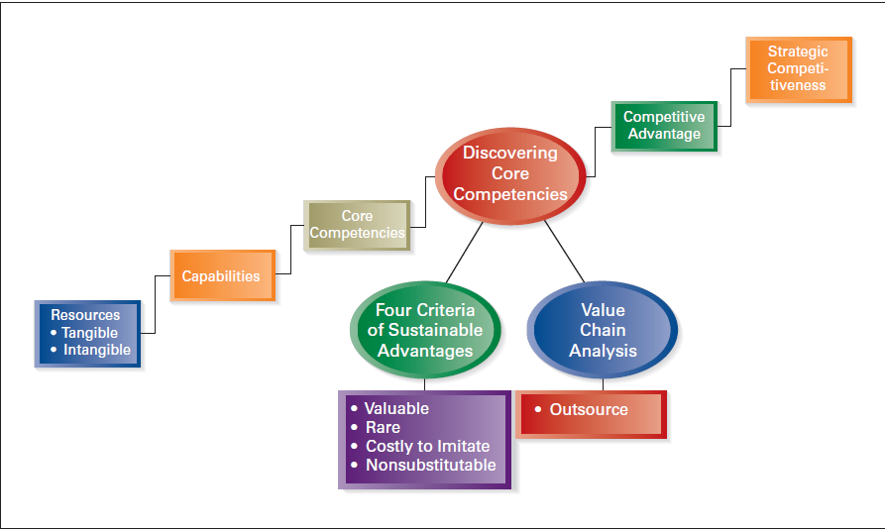
Components of internal analysis

Slide 9
Resources
Resources refer to the assets of a company
A company’s resources two types: tangible and intangible resources.
Tangible resources are physical entities/assets that can be observed and quantified.
Land,buldings,Production equipment, manufacturing facilities, distribution centers, inventory and money
Intangible resources : are nonphysical entities that are created by managers and other employees
are relatively difficult for competitors to analyze and imitate.
Eg. Knowledge, trust between managers and employees, managerial capabilities, organizations scientific capabilities, the capacity for innovation, brand name, and the firm’s reputation and the intellectual property of the company, including patents, copyrights, and trademarks

Slide 10
Tangible Resources
Financial resources
The firm’s borrowing capacity
The firm’s ability to generate internal funds
Organization resources
The firm’s formal reporting structure and its formal planning, controlling, and coordinating system
Physical Resources
Sophistication and location of a firm’s plant and equipment
Access to raw materials
Technological Resources
Stock of technology, such as patents, trademarks, copy rights and trade secrets

Slide 11
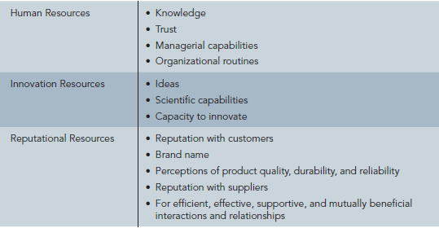
Intangible Resources

Slide 12
Capabilities
A company’s skills at coordinating its resources and putting them to productive use.
exist when resources have been purposely integrated to achieve a specific task or set of tasks.
The foundation of many capabilities lies in the unique skills and knowledge of a firm’s employees and, often, their functional expertise.
Capabilities are intangible. They reside not in individuals, but in the way individuals interact, cooperate, and make decisions within the context of an organization.
capabilities are particularly valuable if they enable a company to create strong demand for its products, and/or to lower its costs

Slide 13
Competencies
Are the special qualities of organization that make them withstand the pressure of competition in the market place .
The capability to use the competencies exceedingly turns them in to core competencies.
Core competencies/distinctive competence-is a specific ability is possessed by a particular organization exclusively or relatively in large measure
Any advantage a company has over its competitor b/c they can do something which they cannot or it can do better than they can
A distinctive competence is unique strength that allow a company to achieve a superior efficiency, quality ,innovation or customer responsiveness and there by superior value and achieve a competitive advantage
A firm’s strengths that cannot be easily matched or imitated by competitors

Slide 14
Strategic and competitive Advantage
Strategic Advantage : outcome of organizational capabilities
Are the result of organizational activities leading to reward in terms of
financial parameters i.e profit /shareholders value
Non-financial parameters -.i.e market share ,reputation
Competitive Advantage: is a special case of strategic advantage where is one or more identified rivals against whom the reward or penalties could measured.

Slide 15
Sustainable Competitive Advantage
Capabilities must fulfill four specific criteria in order to be CORE COMPETENCIES
Valuable
Rare
Costly-to-imitate
Non-substitutable capabilities

Slide 16
VALUABLE CAPABILITIES: Help a firm neutralize threats or exploit opportunities
RARE CAPABILITIES: Are not possessed by many others
COSTLY-TO-IMITATE CAPABILITIES
• Historical: A unique and a valuable organizational culture or brand name
Ambiguous cause: The causes and uses of a competence are unclear
Social complexity: Interpersonal relationships, trust, and friendship among managers, suppliers, and customers
NONSUBSTITUTABLE CAPABILITIES
No strategic equivalent
Firm-specific knowledge
Organizational culture
Superior execution of the chosen business model

Slide 17
SUSTAINABLE COMPETITIVE ADVANTAGE
Exists only when competitors cannot duplicate a firm’s strategy or when they lack the resources to attempt imitation
Exists until competitors can successfully imitate a good, service, or process
Lasts for a relatively long period of time if all four of the criteria discussed are satisfied

Slide 18
Analysis of organizational factors
Other terms which an organization factors are strategic factors, strategic advantage factor ,corporate competence factors,
Organizational capability factor ( or, simply, capability factors) are the strategic strength and weakness existing in different functional areas within the organization ,which are of crucial importance to strategy formulation and implementation
consider capability factors in the six functional areas of finance, marketing, operations, personnel, information , and general management

Slide 19
Financial capability
related to the availability, usage, and management of funds and all allied aspects that have a bearing on an organization’s capacity and ability to implement its strategy
the important factors :
Factors related to source of funds
Factors related to usage of funds
Factors related to management of funds
Strength that support financial capability
Access to financial sources
Amicable relationship with financial institutions
High level of credit worthiness
Efficient capital budgeting system
Low cost of capital as compared with competitors
High level of shareholders confidence
Effective management control system

Slide 20
Marketing capability
relate to the pricing, promotion and distribution of product or services and all the allied aspects on an organization’s capacity and ability to implement its strategies
the important factors
Product related factor (i.e. variety ,differentiation, mix quality, positioning, packaging
Price related factors(i.e pricing objectivities, policies , changes protection ,advantage)
Place related factors (i.e Distribution, transportation and logistics ,marketing channels, marketing intermediaries )
Promotion related Factors ( i.e promotion tools, sales promotion, advertising public relations )

Slide 21
Typical strength that support marketing capability
Wide variety of products
Better quality of products
Sharply –focused positioning
Low prices as compared to those of similar products
High quality customer service
Effective distribution system
Effective sales promotion
Favorable company and product image
Effective marketing management information system

Slide 22
Production capability
relate to the production of products or services , use of material resources and all allied aspects that has bearing on an organization's capacity and ability to implement its strategies.
the important factors
Factors related to the product system : Capacity, location, layout, product or service design , work system, degree of automation
Factors related to the operations and Control system: Aggregate production planning, material Supply, inventory, cost and quality control ,maintenance system and procedure
Factors related to R&D system:
Example
High level of capacity utilization
Favorable plant locations
Reliable source of vertical integration
Effective control of operational cost
Existence of good inventory control system

Slide 23
Personnel Capability
relate to the existence and use of human resource and skills , and all allied aspects that have bearing on an organization's capacity and ability to implement its strategies
important factors
Factors related to the personnel system: system for manpower planning ,selection, development, compensation etc
Factors related to organizational and employee characteristics: corporate image, quality of managers’, staff and workers perceptions about and image of the organization , availability of development opportunities for employees , working condition
Factors related to industrial relations: union-management relationship, collective bargaining ,safety, welfare and security ,employee satisfactions and morale

Slide 24
Example
Genuine concern for HRM and development
Efficient and effective personnel system
Excellent training opportunities and facilities
Highly satisfied and motivated work force
High level of organizations loyalty
Safe and salutary working conditions

Slide 25
Information management capability
factors relate to the design and management of the flow of information from outside into, and within an organization for the purpose of decision making and all allied aspects that have a bearing on an organization’s capacity and ability to implement its strategies
important factors
Factor related to acquisition and retention of information
Factors related to processing and synthesis of information
Factors related to retrieval and usage of information
Integrative, systematic and supportive factors

Slide 26
Eg. typical strength
Ease and convenience of access to information sources
Widespread use of computerized information system
Availability and operability of high-tech equipment
Positive attitude to sharing and disseminating information
Wide coverage and networking of computer systems

Slide 27
General management Capability
relates to the integration, coordination’s and direction of the functional capabilities towards common goals and all allied aspects that have a bearing on an organization’s capacity and ability to implement its strategies
important factors
Factors related to the general management system
Factors related to general manager
Factors related to the organizational climate
Example
Effective system for corporate planning
Control, reward and incentive system for top managers geared to the achieve of objectives
Entrepreneurial orientation and high propensity of risk taking
Favorable corporate image

Slide 28
Techniques used for organizational Appraisal
used for organizational appraisal can be identical to those who used for the performance evaluation of the organization
techniques used could be classified as broadly in three parts as below
Internal Analysis
VRIO framework -Value chain analysis
Quantitative analysis -Qualitative analysis
-Financial analysis
-Non- financial analysis
Comparative Analysis
-Historical analysis -Industry norms
- Bench marking
Comprehensive Analysis
-Key factor rating -Business intelligence system
-Balanced scorecard

Slide 29
Internal Analysis
The internal analysis of an organization deals with an investigation into its strength and weakness by focusing on factors that are specific to it
VRIO framework: Valuable, rare, inimitable and organized for usage
Valuable: helps a firm to generate revenue by capitalizing on opportunities and/or to reduce costs by neutralizing threats
Rare: the possessed by the firm exclusively or just by a few other firms in the industry.
Inimitable : impossible ,very difficult or not worthwhile to duplicate or substituted by the competitor
Organization for usage: appropriate organizational structure , business process, control systems and reward system that are present in the firm

Slide 30
Are the capabilities valuable? | Are the capabilities rare? | Are the capabilities cost to imitate? | Are the capabilities organized to usage? | Are the capabilities strength or weakness?
no | - | - | No | Weakness
yes | no | - | yes | Strength
yes | yes | no | yes | Strength and distinctive competence
yes | yes | yes | yes | Strength and sustainable distinctive competence

Slide 31
Value Chain Analysis
The term value chain refers to the idea that a company is a chain of activities that transforms inputs into outputs that customers value
Assessing the strength and weakness of an organization based on an understanding of the series of activities it performs.
A value chain is a set of interlinked value-creating activities performed by an organization.
The value chain of a manufacturing organization can divide into
Primary and
supporting activities

Slide 32
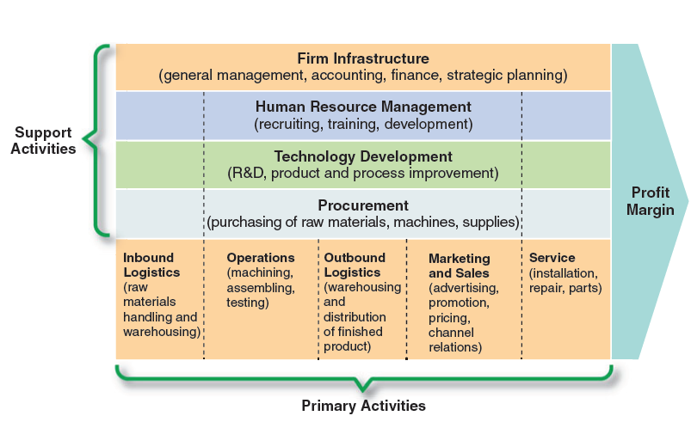

Slide 33
Primary activities
are directly related to the flow of the product to the customer and include five sub activities as listed below
Inbound logistics: All activities that an organization uses for receiving, storing and transporting inputs going into the production process
Operations: All activities required for transformations of raw materials to finished products
Outbound logistics: all activities that an organization uses for receiving ,storing and transporting outputs going out of the production process
Marketing and sales: All activities that an organization uses to market and sell its product to customers
Service: All activities that an organization uses for enhancing and maintaining a product value

Slide 34
Support activities
provide the assistance necessary for the primary activities to take place these consist of
Firm infrastructure; consists of many activities
Human resource management: all activities that an organization uses for managing human resource
Technology development: All activities that an organization uses for creating, developing, and improving products and services
Procurement: All activities that an organization uses for procuring inputs needed to produce products or provide services

Slide 35
The value chain analysis requires(steps)
Identifying activities that make up the organizations value chain and classifying them into
primary and
supporting activities
Identify the things done in those activities that contribute to providing value for the customer
Identifying how the value contribution can be increased so that it costs less to provide the same or more value, thereby increasing the profit margin for the organization
Identifying how the value configuration can be improved by innovatively reconfiguring or recombining activities

Slide 36
Quantitative analysis
A. Financial analysis-the traditional method used for evaluating financial performance, cover various types of activities in different functional areas within an organization
Technique
Ratio Analysis
Economic value Added
Activity Based costing
B. Non-financial quantities analysis : The expression of several intangibles of an organization in monetary terms is neither possible nor desirable
C. Qualitative analysis: Quantitative tools cannot be applied to all internal factors, and the normative judgments of key planning participants may be used in evaluation

Slide 37
Comparative analysis
Historical Analysis: one way to compare its own organizations over a period of time.
measure of how well or badly an organization has progressed with respect to its own past performance.
Industry norm: the may determinants of success in industry may be used to identify the strength and weakness of a firm.
Benchmarking: A bench mark is a reference point for taking measure against .
aimed at finding the best practices within and outside the industry to which an organization belongs

Slide 38
Types of benchmarking
Based on finding what is compared
Performance benchmarking
Process benchmarking
Strategic benchmarking
Based on whom it should compare itself
Internal benchmarking
Competitive benchmarking
Functional benchmarking
Generic benchmarking

Slide 39
Comprehensive analysis
Business Intelligence system
A broad category of applications and technologies for gathering, storing, analyzing, and providing access to data to help enterprise users make better business decision
Eg Decision support system, online analytical processing, statistical analysis , forecasting
Balanced Scorecard/BSC/:
to build a holistic system of measurements
complements that financial measures on customer satisfaction, internal process , and organizational processes, and the organization’s innovation and improvement activities

Slide 40
Cont..
The BSC identifies four key performance measures as follows
Customer perspective : “how do customers see us”
Internal business perspective:”what must we excel at?’
Innovation and learning perspective:”can we continue to improve and create value?”
Financial perspective:”how do we look at shareholders”

Slide 41
SWOT analysis
Strengths – what the organization does well, features it should build on
Weaknesses – problems the organization has, areas it should improve
Opportunities – openings that can help the organization
Threats – hazards that can damage it.

Slide 42
Strengths and weaknesses concern the organization's internal operations and show its distinctive competence.
Strengths are positive internal characteristics that the organization can exploit to achieve its strategic performance goals.
Weaknesses are internal characteristics that might inhibit or restrict the organization’s performance.
Opportunities and threats relate to external features, concentrating on the business environment.
Threats are characteristics of the external environment that may prevent the organization from achieving its strategic goals.
Opportunities are characteristics of the external environment that have the potential to help the organization achieve or exceed its strategic goal

Slide 43
Cont…
simple application of SWOT analysis involves these steps
Setting the objective of the organization or its unit
Identify strength, weakness, opportunity and threat
Ask the following question how do we maximize our strength? how do we minimize our weakness? How do we capitalize opportunities? How e do protect ourselves from threat?
Recommending strategies that will optimize the answer from the four questions?

Slide 44
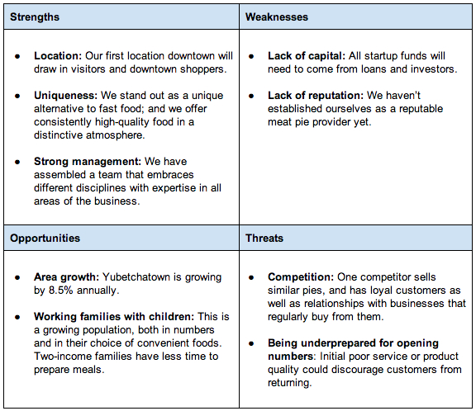

Slide 45
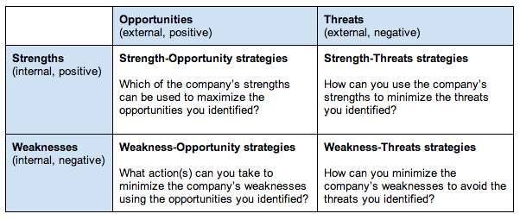

Slide 46
Structuring organizational Analysis
Preparing Strategic advantage profile
Strategic Advantage profile : is a detailed document that divides each of the function or factors into several subsectors
Preparing capability profile:
Capability profile
A techniques of assigning weight to each factor to determine the degree to which a factor is an advantage or disadvantage
Helps as a tool to assess the relative strengths and weakness of an organization in each of the functional areas and identify the gap that need to be filled

