Slide 1
CHAPTER FOUR
Environmental Analysis

Slide 2
Chapter objective
At the end of the chapter students able to know :
The nature of external audit
Source of external information
Forecasting tools and techniques
Competitive analysis: Porter’s five forces model

Slide 3
Concept of environment
Literally –the surrounding ,external objects influence or circumstances under which someone or something exist
Organization –the aggregate of all conditions ,events and influences that surround and affect it
Environment :
External/Macro/general environment and
Internal Environment

Slide 4
Types of environment
Internal Environment : all factors within an organization that impact strength or cause weakness of a strategic nature
External environment : all factors outside the organization which provide opportunities or pose threats to the organization
The environment in which an organization exist can ,therefore, be described in terms of the
strengths and weakness existing in the internal environment
the opportunities and threats operating in the external environment

Slide 5
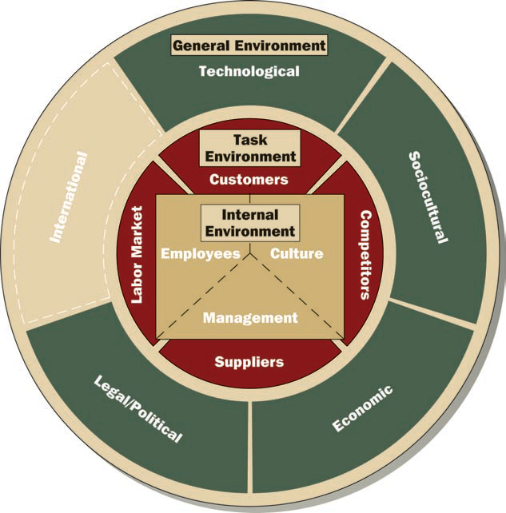
Cont…

Slide 6
External organizational environment: includes all elements existing outside the boundary of the organization that have the potential to affect the organization
General environment: The layer of the external environment that affects the organization indirectly.
The dimensions of the general environment include international, technological, socio-cultural, economic, and legal-political.
Task environment is closer to the organization and includes the sectors that conduct day-to-day transactions with the organization and directly influence its basic operations and performance.

Slide 7
The international dimension is the external environment represents events originating in foreign countries as well as opportunities for Ethiopian companies in other countries
The technological dimension includes scientific and technological advancements in a specific industry as well as in society at large.
The socio-cultural dimension of the general environment represents the demographic characteristics as well as the norms, customs, and values of the general population.
Important socio-cultural characteristics are geographical distribution and population density, age, and education levels.

Slide 8
The economic dimension represents the general economic health of the country or region in which the organization operates.
Consumer purchasing power, the unemployment rate, and interest rates are part of an organization’s economic environment.
The legal-political dimension includes government regulations at the local, state, and federal levels, as well as political activities designed to influence company behavior.

Slide 9
THE SEVEN COMPONENTS OF THE MACRO ENVIRONMENT
Component | Description
Demographics | The size, growth rate, and age distribution of different sectors of the population. It includes the geographic distribution of the population, the distribution of income across the population, and trends in these factors.
Social forces | Societal values, attitudes, cultural factors, and lifestyles that impact businesses. Social forces vary by locale and change over time.
Political, legal, and regulatory factors | Political policies and processes, as well as the regulations and laws with which companies must comply—labor laws, antitrust laws, tax policy, regulatory policies, the political climate, and the strength of institutions such as the court system.
Natural environment | Ecological and environmental forces such as weather, climate, climate change, and associated factors like water shortages.
Technological factors | The pace of technological change and technical developments that have the potential for wide-ranging effects on society, such as genetic engineering, the rise of the Internet, changes in communication technologies, and knowledge and controlling the use of technology,
Global forces | Conditions and changes in global markets, including political events and policies toward international trade, sociocultural practices and the institutional environment in which global markets operate.
General economic conditions | Rates of economic growth, unemployment, inflation, interest, trade deficits or surpluses, savings, per capita domestic product, and conditions in the markets for stocks and bonds affecting consumer confidence and discretionary income.

Slide 10
Suppliers People and organizations who provide the raw materials the organization uses to produce its output.
Labor market The people available for hire by the organization
Customers People and organizations in the environment who acquire goods or services from the organization
Competitors Other organizations in the same industry or type of business that provide goods or services to the same set of customers.

Slide 11
Forecasting tools and techniques
85

Slide 12
The Five Competitive Forces That Shape Strategy ( Michael Porter)
sustaining long-term profitability requires responding strategically to competition. However, the critical questions is do firms look beyond their direct competitors?
Porter explains the need also to look to other forces beyond rivalry among existing competitors

Slide 13
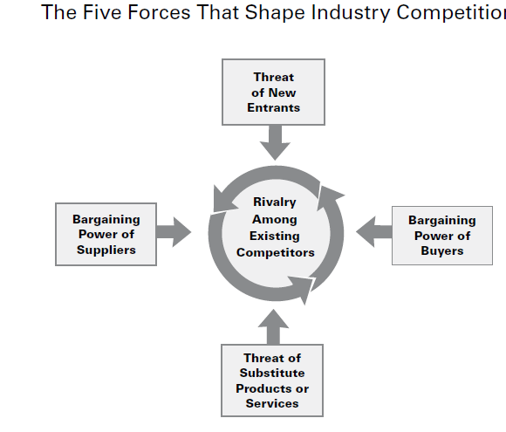

Slide 14
Using the Five-Forces Model of Competition
Step 1
For each of the five forces, identify the different parties involved, and the specific factors that bring about competitive pressures.
Step 2
Evaluate how strong the pressures stemming from each of the five forces are (strong, moderate to normal, or weak).
Step 3
Determine whether the strength of the five competitive forces, overall, is conducive to earning attractive profits in the industry.

Slide 15
Common “Weapons” for Competing with Rivals
Competitive Weapons | Primary Effects
Price discounting, clearance sales, “blowout” sales | Lowers price (P), acts to boost total sales volume and market share, lowers profit margins per unit sold when price cuts are big and/or increases in sales volume are relatively small
Couponing, advertising items on sale | Acts to increase unit sales volume and total revenues, lowers price (P), increases unit costs (C), may lower profit margins per unit sold (P – C)
Advertising product or service characteristics, using ads to enhance a company’s image or reputation | Boosts buyer demand, increases product differentiation and perceived value (V), acts to increase total sales volume and market share, may increase unit costs (C) and/or lower profit margins per unit sold
Innovating to improve product performance and quality | Acts to increase product differentiation and value (V), boosts buyer demand, acts to boost total sales volume, likely to increase unit costs (C)
Introducing new or improved features, increasing the number of styles or models to provide greater product selection | Acts to increase product differentiation and value (V), strengthens buyer demand, acts to boost total sales volume and market share, likely to increase unit costs (C)
Increasing customization of product or service | Acts to increase product differentiation and value (V), increases switching costs, acts to boost total sales volume, often increases unit costs (C)
Building a bigger, better dealer network | Broadens access to buyers, acts to boost total sales volume and market share, may increase unit costs (C)
Improving warranties, offering low-interest financing | Acts to increase product differentiation and value (V), increases unit costs (C), increases buyer costs to switch brands, acts to boost total sales volume and market share

Slide 16
According to Porter , the four additional
competitive forces can hurt firm’s prospective
profits are
Savvy customers who can force down prices by playing you and your rivals against one another.
Powerful suppliers who may constrain your profits if they charge higher prices.
Aspiring entrants , who are armed with new capacity and hungry for market share, can ratchet up the investment required for you to stay in the game.
Substitute offerings that can lure/ attract customers away.

Slide 17
By understanding how the five competitive forces influence profitability in the industry, firms can develop strategies for enhancing their long-term profits. Porter suggests the following:
position your company where the forces are weakest
exploit changes in the forces
reshape the forces in your favour

