Slide 1
Strategic Management MGMT 462
By Mesfin M. (MBA)

Slide 2
PART ONE: OVERVIEW OF STRATEGIC MANAGEMENT
Chapter 1: The Nature of Strategic Management

Slide 3
LEARNING OBJECTIVES
At the end of this session you should be able to:
Explain what is strategic management is,
Explain Stages of strategic management
Understand Key terms in strategic management
Justify why it is important for an organisation to have a viable business model that outlines the organisation’s customer value proposition and its profit formula.
Explain the benefits of strategic management

Slide 4
OPENING QUESTION
What is strategy?
Why has Apple been so successful with the iPod, iTouch, iPhone?
Why has McDonald’s healthier menu been effective?
Why is Ethiopia successful in aviation industry?

Slide 5
Definition
Strategy as a decision-making process is defined as:
Those decisions which have high medium-term to long-term impact on the activities of the organisation, including the analysis leading to the resourcing and implementation of those decisions, to create value for customers and key stakeholders and to outperform competitors
Finding ways to respond to competitors, and cope with change is strategy.

Slide 6
Cont...
Strategy is about
decision making
long-term impacts
integration and focus
implementation of decisions
creating value for customers and key stakeholders
outperforming competitors
Needed by all organisations, not just companies or profit-making entities

Slide 7
Cont...
Strategy is all about How:
How to outcompete rivals.
How to respond to economic and market conditions and growth opportunities.
How to manage functional pieces of the business.
How to improve the firm’s financial and market performance.

Slide 8
What is Strategic Management?
0
The art and science of formulating, implementing, and evaluating cross-functional decisions that enable an organization to achieve its objectives
Plans and actions that lead to superior competitive standing
Who are our competitors and what are their strengths and weaknesses?
Who are our customers?
What products or services should we offer?
What does the future hold for our industry?
How can we change the rules of the game?
Strategic management is a set of managerial decisions and actions that determines the long run performance of a corporation.

Slide 9
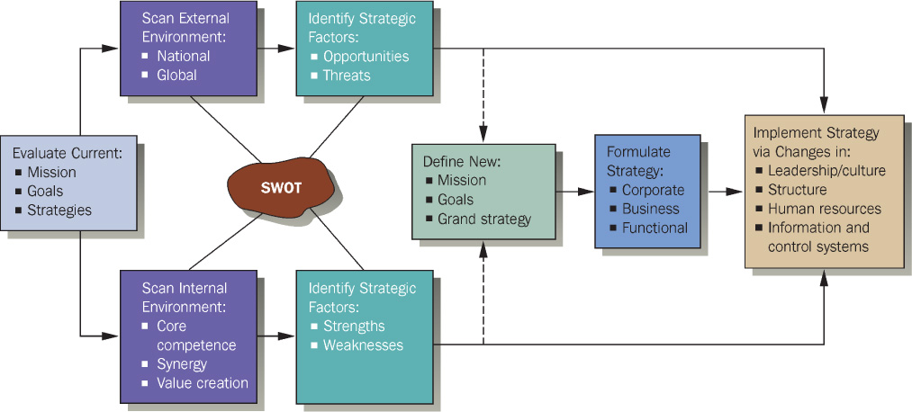
The Strategic Management Process
0

Slide 10
Stages of Strategic Management
The strategic-management process consists of three stages:
1. Strategic formulation: Selecting strategies based on analysis of an organization’s external and internal environment
Strategy formulation includes
developing a vision and mission,
identifying an organization’s external opportunities and threats,
determining internal strengths and weaknesses,
establishing long-term objectives, generating alternative strategies, and
choosing particular strategies to pursue

Slide 11
Cont…
Strategy-formulation issues include
deciding what new businesses to enter
what businesses to abandon
how to allocate resources
whether to expand operations or diversify
whether to enter international markets
whether to merge or form a joint venture, and
how to avoid a hostile takeover

Slide 12
2. Strategy implementation requires
a firm to establish annual objectives, devise policies,
motivate employees, and
allocate resources so that formulated strategies can be executed.
Strategy implementation includes
developing a strategy-supportive culture,
creating an effective organizational structure,
redirecting marketing efforts
preparing budgets, developing and utilizing information systems, and linking employee compensation to organizational performance
Strategy Execution
Directing resources
Accomplishing results
Changes in structure
Use managerial and organizational tools

Slide 13
3. Strategy evaluation: All strategies are subject to future modification because external and internal factors are constantly changing.
Three fundamental strategy-evaluation activities are
reviewing external and internal factors that are the bases for current strategies,
measuring performance, and
Taking corrective actions.

Slide 15
Key Terms in Strategic Management
Competitive Advantage
This term can be defined as “anything that a firm does especially well compared to rival firms.”
Superior performance relative to other competitors in the same industry or the industry average
When a firm can do something that rival firms cannot do, or owns something that rival firms desire, that can represent a competitive advantage.
Normally, a firm can sustain a competitive advantage for only a certain period due to rival firms imitating and undermining that advantage.

Slide 16
Cont..
A firm must strive to achieve sustained competitive advantage by
continually adapting to changes in external trends and events and internal capabilities, competencies, and resources; and by
effectively formulating, implementing, and evaluating strategies that capitalize upon those factors

Slide 17
Strategists
Strategists are the individuals who are most responsible for the success or failure of an organization
Strategists help an organization gather, analyze, and organize information.
They track industry and competitive trends, develop forecasting models and scenario analyses, evaluate corporate and divisional performance, spot emerging market opportunities, identify business threats, and develop creative action plans
Three principal responsibilities
Creating a context of change
Building commitments and motivation
Balancing stability and innovation

Slide 18
3. Vision and Mission Statements
vision statement that answers the question “What do we want to become?”
Vision without Action is a Daydream
Action without Vision is a Nightmare
Not Optional
Stretch – 30+ Years
8-10 Words in length
Future State
Brief and Memorable
Inspiring and Challenging
Descriptive of the Ideal

Slide 19
Cont…
Mission statements are “enduring statements of purpose that distinguish one business from other similar firms. What is our purpose?
A mission statement identifies the scope of a firm’s operations in product produced and service rendered to customers .
It addresses the basic question that faces all strategists: “What is our business?” why we are there?
A clear mission statement describes the value and priorities of the organization.

Slide 20
4. External Opportunities and Threats
refer to economic, social, cultural, demographic, environmental, political, legal, governmental, technological, and competitive trends and events that could significantly benefit or harm an organization in the future
Opportunities and threats are largely beyond the control of a single organization—thus the word external
Opportunity : is a favorable conditions in the organizations environment which enables it to consolidate and strengthen its position
Threat is an unfavorable condition in the organization's environment w/c creates a risk for, or causes damage to ,the organization.

Slide 21
Cont..
5. Internal Strengths and Weaknesses
Internal strengths and internal weaknesses are an organization’s controllable activities that are performed especially well or poorly.
Identifying and evaluating organizational strengths and weaknesses in the functional areas of a business is an essential strategic management activity.
Organizations strive to pursue strategies that capitalize on internal strengths and eliminate internal weaknesses

Slide 22
6. Long-Term Objectives
Objectives can be defined as specific results that an organization seeks to achieve in pursuing its basic mission
Long-term means more than one year.
Objectives are essential for organizational success because
they state direction
aid in evaluation
create synergy
reveal priorities
focus coordination and
provide a basis for effective planning, organizing, motivating, and controlling activities
Objectives should be challenging, measurable, consistent, reasonable, and clear

Slide 23
Cont--
7. Strategies
Is a compressive master plan stating HOW the organization will achieve its mission and objectives.
Strategies are the means by which long-term objectives will be achieved.
Business strategies may include
geographic expansion,
Diversification
Acquisition
product development,
market penetration,
retrenchment,
Divestiture
liquidation, and joint ventures.

Slide 24
Cont…
8. Annual Objectives
Annual objectives are short-term milestones that organizations must achieve to reach long term objectives
Annual objectives are especially important in strategy implementation, whereas long-term objectives are particularly important in strategy formulation

Slide 25
Cont..
9. Policies
Policies are the means by which annual objectives will be achieved.
Policies include guidelines, rules, and procedures established to support efforts to achieve stated objectives.
Policies are guides to decision making and address repetitive or recurring situations.

Slide 26
Strategic Management Model
Scanning
Where are we now?
Strategy Formulation
Where do we want to be?
Strategy Implementation
How do we get there?
Measurement/Performance
How do we measure our progress?

Slide 27
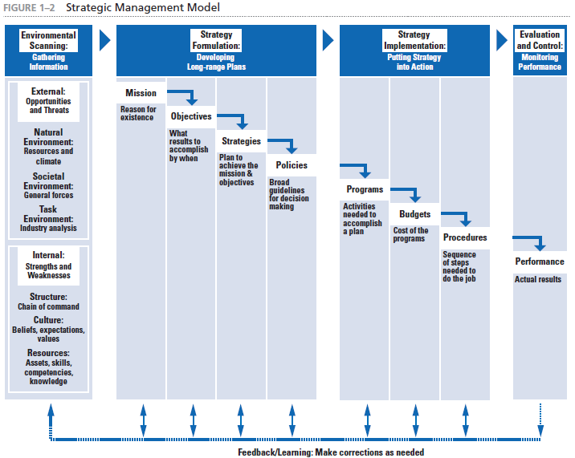

Slide 29
Purpose of Strategy
0
Strategy:
Plan of action
Resource allocation
Activities for dealing with the environment
Achieving competitive advantage
Strategy should:
Exploit Core Competence
Build Synergy
Deliver Value

Slide 30
Benefits of strategic management
Clearer sense of strategic vision for the firm.
Sharper focus on what is strategically important.
Improved understanding of a rapidly changing environment

