Slide 1
CHAPTER SIX
Strategy Analysis and Choice/Strategy Formulation

Slide 2
Stages of Strategic Management
Strategic Management process consists of three stages:
Strategy formulation,
Strategy implementation, and
Strategy evaluation.

Slide 3
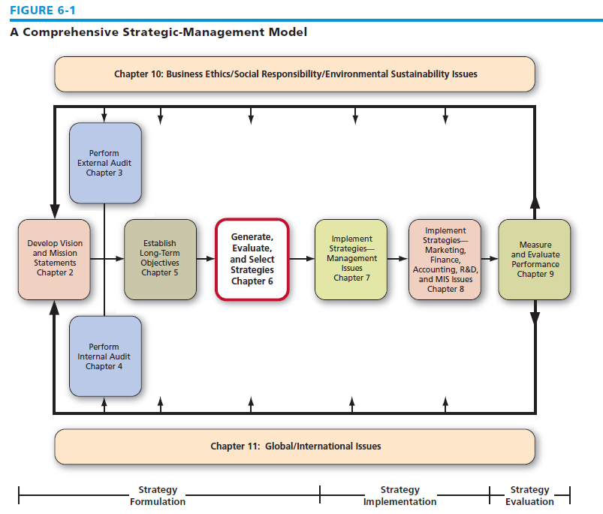
A Comprehensive Strategic-Management Model

Slide 4
Strategy formulation
Strategy formulation includes:
Developing a vision and mission statements
Identifying organization’s external opportunities and threats
Indentifying internal strengths and weaknesses
Setting long-term objectives and alternative strategies
Analyzing alternative strategies and choosing particular strategy.

Slide 5
Nature of Strategy Analysis and choice
Generating and analyzing alternative strategies and selecting a set of strategies involve making subjective decision based on objective information.
Alternative strategies are derived from the organization’s vision, mission, objectives, external audit, and internal audit, and are build on past strategies that have worked well.

Slide 6
Process of Strategy Analysis and Choice
As it’s not possible to consider infinite number of alternative strategies, a manageable set of most attractive alternative strategies are developed.
Identifying and evaluating alternative strategies should involve as many managers and employees as possible from each department who earlier participated in formulation of organizational vision, mission, internal and external audits.
After identifying all feasible strategies, they must be ranked to arrive at a list of prioritized strategies reflecting the collective wisdom of the organization.

Slide 7
The Process of Generating and Selecting Strategies
Nature of Strategy Analysis & Choice
  Establishing long-term objectives
    Generating alternative strategies
    Selecting strategies to pursue
    Best alternative – achieve mission & objectives

Slide 8
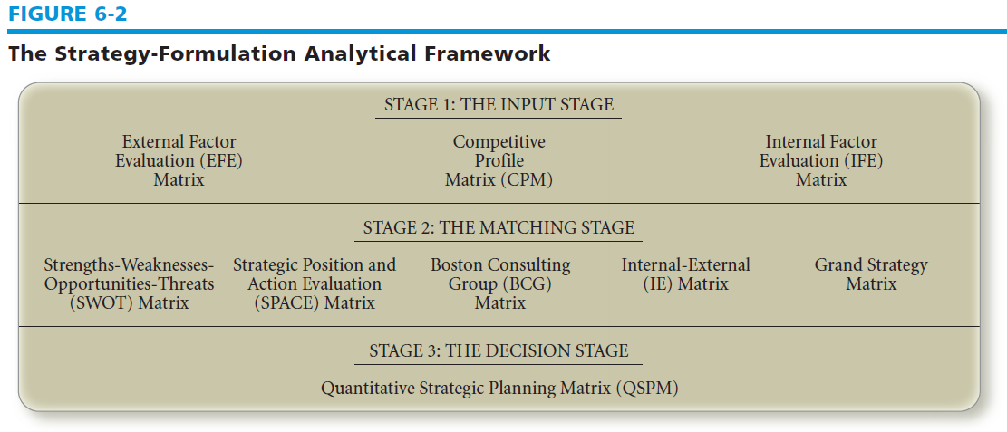
The Strategy-Formulation Analytical Framework

Slide 9
A Comprehensive Strategy-Formulation Analytical Framework (SFAF)
  Stage 1: Input Stage:
  EFE Matrix,
  IFE (Internal Factor Evaluation) Matrix, and
  CP (Competitive Profile) Matrix
  Stage 2: Matching Stage
  SWOT ( Strength-Weakness-Opportunities-Threat) Matrix,
  SPACE (Strategic Position and Action Evaluation) Matrix,
  IE (Internal-External) Matrix,
  GS (Grand Strategy) Matrix
  Stage 3: Decision making stage
  QSP (Quantitative Strategic Planning) Matrix

Slide 10
Strategy-Formulation Analytical Framework
Internal Factor Evaluation
Matrix (IFE)
Stage 1:
The Input Stage
External Factor Evaluation
Matrix (EFE)
Competitive Profile Matrix
(CPM)
Ch 7 -10
Copyright © 2011 Pearson Education

Slide 11
EFE Matrix
An EFE (external factor evaluation) Matrix summarizes and evaluate all the external forces that affect an organization. It is developed in 5 stages:
List key external factors identified in external audit;
Assign to each factor weight ranging from say 0.0 (not important) to 1.0 (very important) indicating relative importance of that factor to be successful in the industry.
Assign rating say between 1 (poor response) and 4 (superior response) based on effectiveness of the organization’s strategies.
Multiply weight by its rating to get weighted score
Sum up to get total weighted score for the organization.

Slide 12
Example of EFE Matrix
Key External Factors | Weight | Rating | Weighted score
Opportunities
1. Domestic demand increasing 10% annually
Export demand increasing 15% annually
3. Input price decreasing 5% annually
Threats
1. Rival organizations increasing ad by 20% annually
2. Govt. Tightening its regulation
3. Interest rates are increasing 3% annually
Total

Slide 13
IFE (Internal Factor Evolution) Matrix
IFE Matrix is a management strategy formulation tool that summarizes and evaluates major strengths and weaknesses in functional areas of the organization.
Five steps to construct IFE Matrix:
  List key strengths and weaknesses
  Assign weight ranging from 0.0 (not important) to 1.0 (all important)
  Assign rating from 1 (major weakness) to 4 (major strength)
  Multiply weights and rating to get weighted score
  Sum the weighted score to get total weighted score for the organization.

Slide 14
An example of IFE Matrix
 | Key Internal Factors | Weight | Rating | Weighted Score
 | Strengths
1
2
3
 | Weaknesses
1
2
3
 | Total Weighted Score

Slide 15
CP (Competitive Profile) Matrix
CP Matrix identifies a organization’s strategic competitors and its particular strengths and weakness in relation to the organization’s strategic position.
CP Matrix is broader as it includes both internal and external issues.
CP Matrix rating refers to strengths and weakness between I (major weakness) and 4 (major strength).

Slide 16
Example of CP Matrix
 |  | Org A |  | Org B |  | Org C
Critical success factors | weight | rating | score | rating | score | Rating | score
Product quality
Price competitiveness
Advertising
Management
Financial position
Market share
Customer loyalty
Global expansion
Total

Slide 17
Stage 2: The Matching Stage
Match between organization’s internal resources & skills and the opportunities & risks created by its external factors
  E.g. internal: strong R and D function
  External changing demographics (population getting older)
  Strategy: Develop new products for older adults (related to long term objectives financial or strategic)

Slide 18
Strategy-Formulation Analytical Framework
SWOT Matrix
SPACE Matrix
Stage 2:
The Matching Stage
BCG Matrix
IE Matrix
Grand Strategy Matrix
Ch 7 -18
Copyright © 2011 Pearson Education

Slide 19
Stage 2: The Matching Stage: 1 SWOT Matrix
Four Types of Strategies
Strengths-Opportunities (SO):
  Use a firm’s internal strengths to take advantage of external opportunities
Weaknesses-Opportunities (WO):
  Improving internal weaknesses by taking advantage
  of external opportunities
Strengths-Threats (ST):
  Use a firm’s strengths to avoid or reduce the impact of external threats.
Weaknesses-Threats (WT):
  Defensive tactics aimed at reducing internal weaknesses and avoiding external threats

Slide 20
SWOT Matrix (contd.)
 | Strength - S 1 2 3 4 | Weakness – W 1 2 3 4
Opportunities –O 1 2 3 4 | SO Strategies 1 2 3 | WO Strategies 1 2 3
Threats- T 1 2 3 4 | ST Strategies 1 2 3 | WT Strategies 1 2 3

Slide 21
SWOT Matrix
Leave Blank | Strengths – S List Strengths | Weaknesses – W List Weaknesses
Opportunities – O List Opportunities | SO Strategies Use strengths to take advantage of opportunities | WO Strategies Overcoming weaknesses by taking advantage of opportunities
Threats – T List Threats | ST Strategies Use strengths to avoid threats | WT Strategies Minimize weaknesses and avoid threats

Slide 22
SWOT Matrix contd.
Eight steps to construct a SWOT Matrix: strategies
Listing key external opportunities
Listing key external threats
Listing key internal strengths
Listing key internal weakness
Matching internal strengths with external opportunities to get the SO
Matching internal weakness with external opportunities to get WO strategies
Matching internal strengths with external threats to get ST strategies
Matching internal weakness with external threats to get WT strategies.

Slide 23
Matching Key Factors to Formulate Alternative Strategies
Key Internal Factor
Key External Factor
Resultant Strategy
Excess working capacity (strength)
+
20% annual growth in the cell phone industry (opportunity)
=
Acquire Cellfone, Inc.
Insufficient capacity (weakness)
+
Exit of two major foreign competitors from the industry (opportunity)
=
Pursue horizontal integration by buying competitor's facilities
Strong R&D (strength)
+
Decreasing numbers of young adults (threat)
=
Develop new products for older adults
Poor employee morale (weakness)
+
Strong union activity (threat)
=
Develop a new employee benefits package
Which types of strategies, e.g. intensive diversification…, are referred to above

Slide 24
Strengths: | Weaknesses:
R and D almost complete Basis for strong management team Key first major customer acquired Initial product can evolve into range of offerings Located near a major centre of excellence Very focused management/staff Well-rounded and managed business | Over dependent on borrowings - Insufficient cash resources Board of Directors is too narrow Lack of awareness amongst prospective customers Need to relocate to larger premises Absence of strong sales/marketing expertise Overdependence on few key staff Emerging new technologies may move market in new directions
Threats: | Opportunities:
Major player may enter targeted market segment New technology may make products obsolescent Economic slowdown could reduce demand Euro/Yen may move against $ Market may become price sensitive Market segment's growth could attract major competition | Market segment is poised for rapid growth Export markets offer great potential Distribution channels seeking new products Scope to diversify into related market segments

Slide 25
Key Strategies
Accelerate product launches by strengthening R and D team
Extend links with key technology centres
Raise additional venture capital
Expand senior management team in sales/marketing
Recruit non-executive directors
Strengthen human resources function and introduce share options for staff
Appoint advisers for intellectual property and finance
Seek new market segments/applications for products

Slide 26
Limitations with SWOT Matrix
Does not show how to achieve a competitive advantage
Provides a static assessment in time
May lead the firm to overemphasize a single internal or external factor in formulating strategies
Ch 7 -26
Copyright © 2011 Pearson Education

Slide 27
2 BCG Matrix
Boston Consulting Group Matrix
Enhances multi-divisional firm in formulating strategies
Autonomous divisions = business portfolio
Divisions may compete in different industries
Focus on market-share position & industry growth rate

Slide 28
BCG Matrix
Relative Market Share Position
Ratio of a division’s own market share in an industry to the market share held by the largest rival firm in that industry

Slide 29
BCG Matrix
Relative Market Share Position
High
1.0
Medium
.50
Low
0.0
Industry Sales Growth Rate
Stars
II
Question Marks
I
High
+20
Medium
0
Cash Cows
III
Dogs
IV
Low
-20

Slide 30
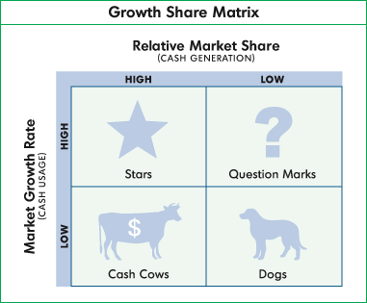
BCG Matrix

Slide 31
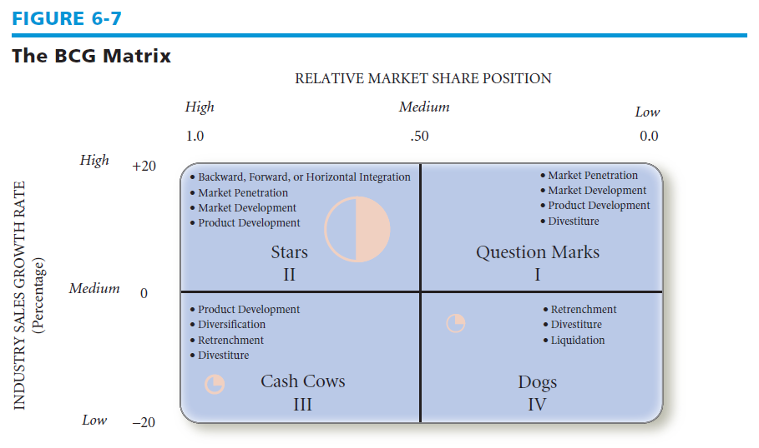
The BCG Matrix

Slide 32
BCG Matrix
Question Marks
Low relative market share – compete in high-growth industry
  Cash needs are high
  Case generation is low
Decision to strengthen (intensive strategies) or divest

Slide 33
BCG Matrix
Stars
High relative market share and high growth rate
  Best long-run opportunities for growth & profitability
Substantial investment to maintain or strengthen dominant position
  Integration strategies, intensive strategies, joint ventures

Slide 34
BCG Matrix
Cash Cows
High relative market share, competes in low-growth industry
  Generate cash in excess of their needs
  Milked for other purposes
Maintain strong position as long as possible
  Product development, concentric diversification
  If weakens—retrenchment or divestiture

Slide 35
BCG Matrix
Dogs
Low relative market share & compete in slow or no market growth
  Weak internal & external position
Liquidation, divestiture, retrenchment

Slide 36
3. SPACE (Strategic Position and Action Evaluation) Matrix
SPACE Matrix in its 4 quadrant framework indicates whether aggressive, conservative, defensive or competitive strategies are appropriate for a organization.
Axes of the SPACE Matrix represent 2 internal and 2 external dimensions.
Internal dimensions are:
  FS (Financial strength)
  CA (Competitive Advantage)
  External dimensions are:
    ES (Environmental Stability)
    IS (Industry Strength)

Slide 37
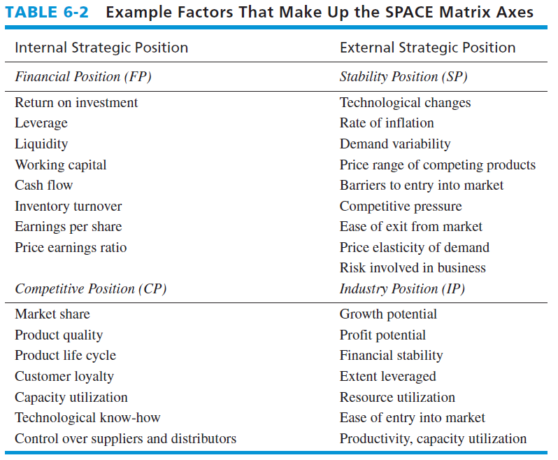
Factors That Make Up the SPACE Matrix Axes

Slide 38
Factors That Make Up the SPACE Matrix Axes

Slide 39
Factors of SPACE Matrix (contd.)
Internal Strategic Position | External Strategic Position
FS (Financial Strengths) | ES (Environmental Stability)
Return on Investment Leverage Ratios Liquidity Ratios Working Capital Cash Flow | 1. Rate of Inflation 2. Price Elasticity of Demand 3. Competitive Pressure 4. Price range of competing products 5. Technological change
CA (Competitive Advantage) | IS (Industry Strength)
Market share Product quality Customer loyalty Control over input suppliers | Growth potential Profit potential Financial stability Productivity

Slide 40
SPACE Matrix (contd.)
FS +
Conservative Strategies Aggressive Strategies
CA IS
_ +
Defensive Strategies Competitive Strategies
ES _

Slide 41
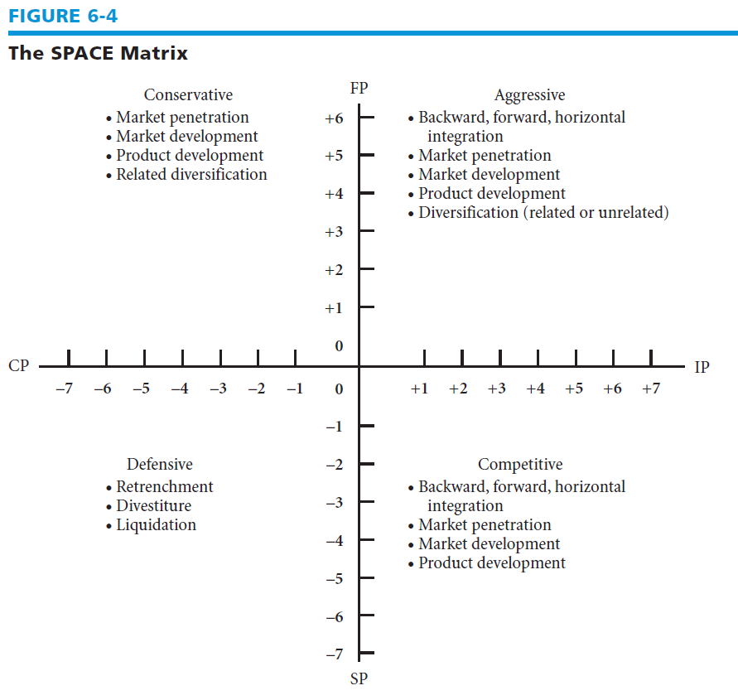
The SPACE Matrix

Slide 42
Steps to Develop a SPACE Matrix
Select a set of variables to define financial position (FP), competitive position (CP), stability position (SP), and industry position (IP)

Slide 43
Steps to Develop a SPACE Matrix
Assign a numerical value ranging from +1 (worst) to +7 (best) to each of the variables that make up the FP and IP dimensions.
Assign a numerical value ranging from –1 (best) to –7 (worst) to each of the variables that make up the SP and CP dimensions

Slide 44
Steps to Develop a SPACE Matrix
Compute an average score for FP, CP, IP, and SP
Plot the average scores for FP, IP, SP, and CP on the appropriate axis in the SPACE Matrix
Add the two scores on the x-axis and plot the resultant point on X. Add the two scores on the y-axis and plot the resultant point on Y. Plot the intersection of the new xy point

Slide 45
Steps to Develop a SPACE Matrix
Draw a directional vector from the origin of the SPACE Matrix through the new intersection point
  This vector reveals the type of strategies recommended for the organization: aggressive, competitive, defensive, or conservative

Slide 46
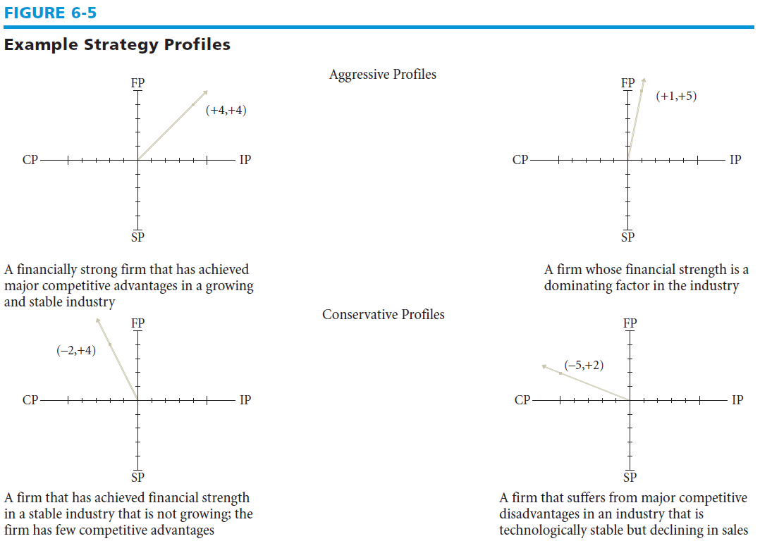
Example Strategy Profiles

Slide 47
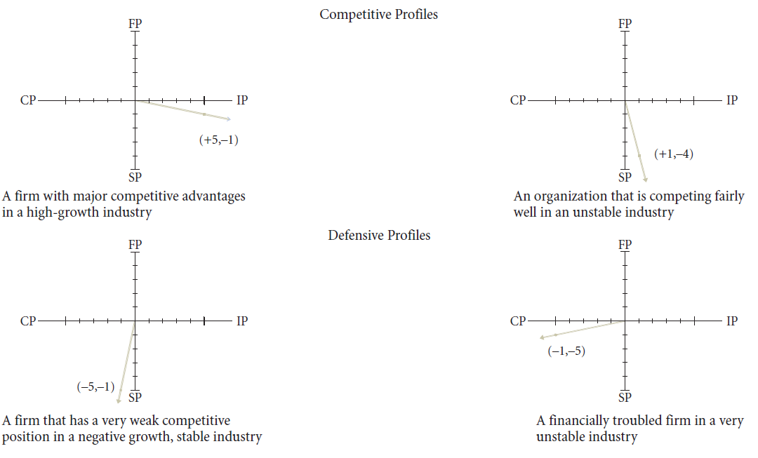
Example Strategy Profiles

Slide 48
A SPACE Matrix for a Bank
SP Average is -13.0 ÷ 3 = -4.33
IP Average is +10.0 ÷ 3 = 3.33
CP Average is -9.0 ÷ 3 = -3.00
FP Average is +9.0 ÷ 4 = 2.25
Directional Vector Coordinates:
        x-axis: -3.00 + (+3.33) = +0.33
        y-axis: -4.33 + (+2.25) = -2.08
The bank should pursue _____________Strategies.

Slide 49
4. The Internal-External Matrix
Positions an organization’s various divisions in a nine-cell display
Similar to BCG Matrix except the IE Matrix:
  Requires more information about the divisions
  Strategic implications of each matrix are different
Ch 7 -49
Copyright © 2011 Pearson Education

Slide 50
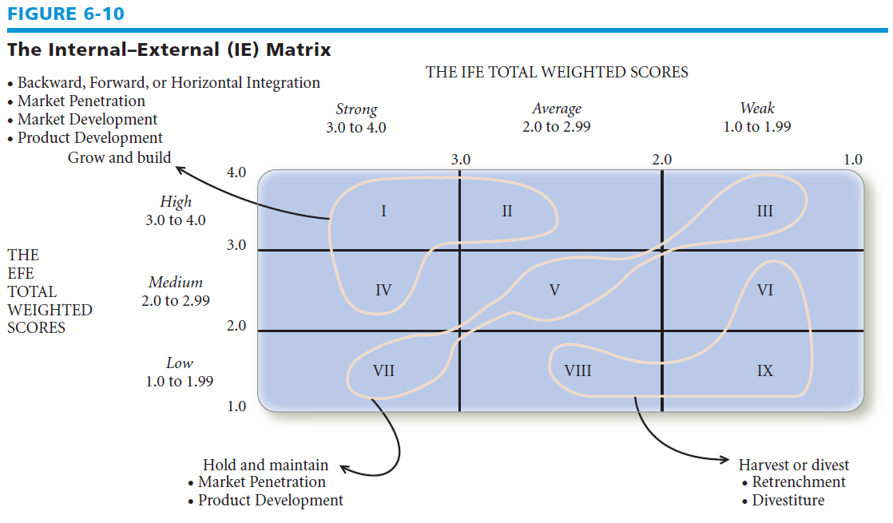
The Internal-External (IE) Matrix

Slide 51
IE Matrix
Based on two key dimensions
  The IFE total weighted scores on the x-axis
  The EFE total weighted scores on the y-axis
Divided into three major regions
  Grow and build – Cells I, II, or IV
  Hold and maintain – Cells III, V, or VII
  Harvest or divest – Cells VI, VIII, or IX
Ch 7 -51
Copyright © 2011 Pearson Education

Slide 52
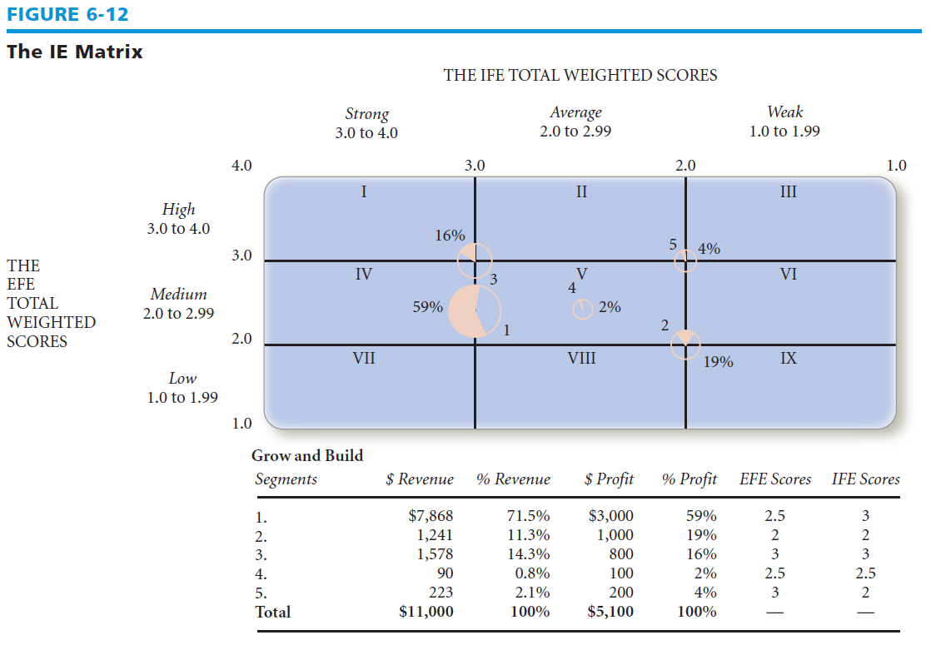
The IE Matrix

Slide 53
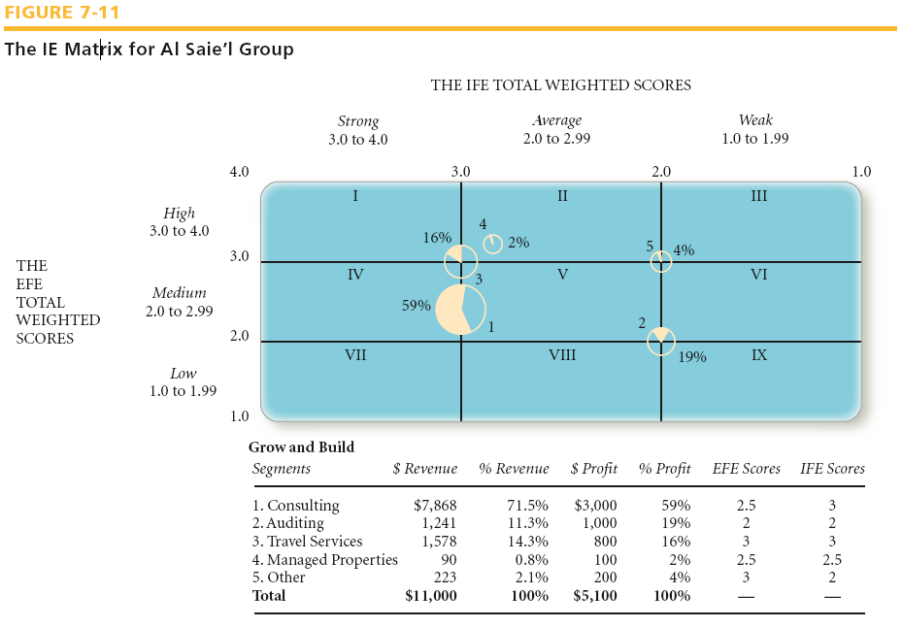
Ch 7 -53
Copyright © 2011 Pearson Education

Slide 54
The Grand Strategy Matrix
Grand Strategy Matrix
  based on two evaluative dimensions:
    competitive position and
    market (industry) growth

Slide 55
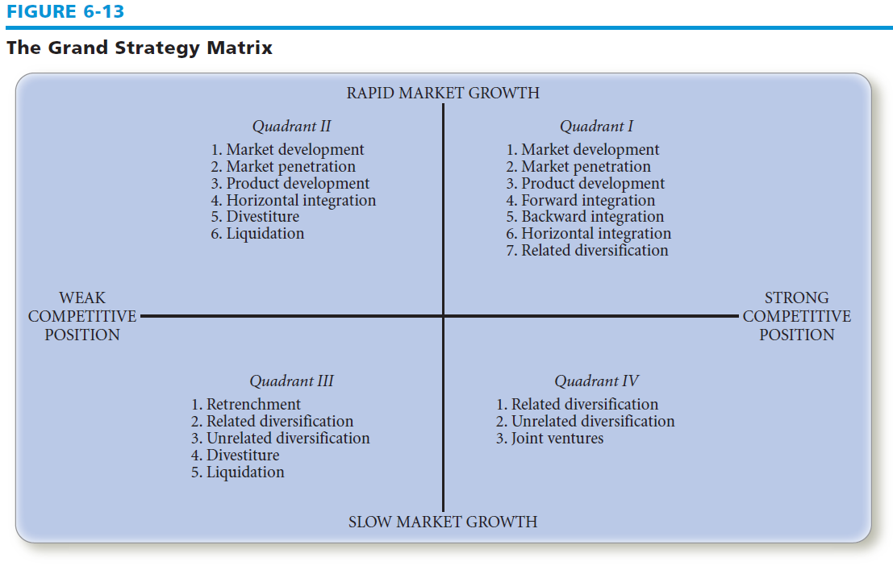
The Grand Strategy Matrix

Slide 56
The Grand Strategy Matrix
Quadrant I
  continued concentration on current markets (market penetration and market development) and products (product development) is an appropriate strategy
Quadrant II
  unable to compete effectively
  need to determine why the firm’s current approach is ineffective and how the company can best change to improve its competitiveness

Slide 57
The Grand Strategy Matrix
Quadrant III
  must make some drastic changes quickly to avoid further decline and possible liquidation
  Extensive cost and asset reduction (retrenchment) should be pursued first
Quadrant IV
  have characteristically high cash-flow levels and limited internal growth needs and often can pursue related or unrelated diversification successfully

Slide 58
Strategy-Formulation Analytical Framework
Stage 3:
The Decision Stage
Quantitative Strategic
Planning Matrix
(QSPM)
Technique designed to determine the relative attractiveness of feasible alternative actions

Slide 59
Steps to Develop a QSPM
Make a list of the firm’s key external opportunities/threats and internal strengths/weaknesses in the left column
Assign weights to each key external and internal factor
Examine the Stage 2 (matching) matrices, and identify alternative strategies that the organization should consider implementing
Determine the Attractiveness Scores (A.S)
Compare the Total Attractiveness Scores
Compute the Sum Total Attractiveness Score

Slide 60
QSPM : information from IFE and EFE
Strategic Alternatives
Key External Factors Economy
Political/Legal/Governmental
Social/Cultural/Demographic/Environmental
Technological
Competitive
Weight
Strategy 1
Strategy 2
Strategy 3
Key Internal Factors
Management
Marketing
Finance/Accounting
Production/Operations
Research and Development
Computer Information Systems
Sum total A.S.
AS 1 to 4 and blank if factor does not effect strategy: TAS = Weight x AS

