Slide 1
PART TWO: STRATEGY FORMULATION
CHAPTER THREE: The Business Mission

Slide 2
Organizational Vision
Vision has become one of the most overused and least understood word
A well-conceived vision consists of two major components:
core ideology , and
envisioned future

Slide 3
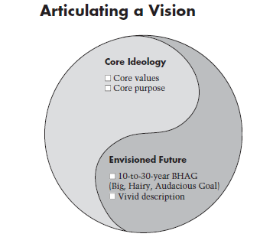

Slide 4
Core ideology
defines a company’s timeless character.
is something you discover —by looking inside and not something you invent.
should not change while its practices ,strategies, markets , customers, and products etc... should change continually
has two parts: core Values and core Purpose

Slide 5
Core values
are the handful of guiding principles by which a company navigates. ( e.g. imagination , Innovation, Empowerment, Integrity, Passion , fun, diversity, team work, community)
These values are nurtured for their own sake, not to capitalize on business opportunities.
A company’s market or strategy or product lines etc... may change to remain true to its core values.
Core purpose
is an organization’s most fundamental reason for being. ( e.g. to make people happy )
reflects the idealistic motivations for doing the company’s work and should not be confused with the company’s current product lines or customer segments.
Company’s core purpose can never be completed

Slide 6
An envisioned future
has two elements: BHAGs and vivid descriptions
Big, Hairy, Audacious Goals (BHAGs) which are ambitious plans that rev up the entire organization and require 10 to 30 years’ work to complete.
Vivid descriptions paint a picture of what it will be like to achieve the BHAGs. They make the goals vibrant, engaging—and tangible.
Don’t confuse
a company’s core ideology with its envisioned future
a BHAG with a core purpose. A BHAG is reachable but core purpose can never be completed.

Slide 7
Examples of BHAG of some companies
Amazon: Every book, ever printed, in any language, all available in less than 60 seconds.
Blackpool FC: Reach English Premier League.
Disney: Be the best company in the world for all fields of family entertainment.
Ford: Democratize the automobile.
Google: Organize the world's information and make it universally accessible and useful.
Hewlett-Packard: Be one of the best managed corporations in the world.
IBM: Commit to a $5 billion gamble on the 360
Microsoft: A computer on every desk and in every home.
Motorola: Sell 100,000 TVs at $179.95
Nokia Siemens Networks: Connect 5 billion people by 2015.

Slide 8
Putting It All Together: Sony in the 1950s
Core Ideology
Core Values
• Elevation of the Japanese culture and national status
• Being a pioneer—not following others; doing the impossible
• Encouraging individual ability and creativity
Purpose
To experience the sheer joy of innovation and the application of technology for the benefit and pleasure of the general public
Envisioned Future
BHAG
Become the company most known for changing the worldwide poor-quality image of Japanese products
Vivid Description We will create products that become pervasive around the world.... We will be the first Japanese company to go into the U.S. market and distribute directly.... We will succeed with innovations that U.S. companies have failed at—such as the transistor radio.... Fifty years from now, our brand name will be as well known as any in the world...and will signify innovation and quality that rival the most innovative companies anywhere.... “Made in Japan” will mean something fine, not something shoddy.

Slide 9
Organizational Mission
0
The mission statement is the reason the organization exists
Top of the goal hierarchy
Describes the values, aspirations and reason for being
A well-defined mission is the basis for all other goals
Mission statements outline the stated purpose and values to stakeholders

Slide 10
Vision statement Vs Mission statement
A vision statement outlines what a company wants to be in the future.
The Vision Statement focuses on the future; it is a source of inspiration and motivation.
Often it describes not just the future of the organization but the future of the industry or society in which the organization hopes to effect change.
The vision statement is, in a sense, loftier.
It outlines the worldview of the organization and why it exists.
It attracts people — not just employees but also customers and vendors — who believe in the vision of the organization.

Slide 11
Cont…
When developing a vision statement, it should be seen that the following questions are answered:
What do we want to do going forward?
When do we want to do it?
How do we want to do it?
Features of an effective vision statement include:
Clarity and lack of ambiguity
Paint a vivid and clear picture, not ambiguous
Describing a bright future (hope)
Memorable and engaging expression
Realistic aspirations, achievable
Alignment with organizational values and culture
Time bound if it talks of achieving any goal or objective

Slide 12
Mission statement
The Mission Statement concentrates on the present; it defines the customer(s), critical processes and it informs you about the desired level of performance.
The mission statement guides the day-to-day operations and decision-making of the organization.
It helps in tactical planning and "rallying the troops" around a common near- to medium-term goal.
The mission statement helps members of the organization get on the same page on what they should do and how they should do it.

Slide 13
What to Include in a Mission Statement
When developing a mission statement, it should be seen that the following questions are answered:
What do we do today?
For whom do we do it?
What is the benefit?
Features of an effective mission statement are:
Purpose and values of the organization
What business the organization wants to be in (products or services, market) or who are the organization's primary "clients" (stakeholders)
What are the responsibilities of the organization towards these "clients"
What are the main objectives that support the company in accomplishing its mission

Slide 14
Examples
Wal-Mart
Vision St:-to become the worldwide leader in retailing.
Mission St:- to help people save money so they can live better.
Ethiopian airline
To become the leading Aviation group in Africa by providing safe and reliable passenger and cargo air transport, Aviation Training, Flight Catering, MRO and Ground Services whose quality and price “value proposition” is always better than its competitors,
To ensure being an airline of choice to its customers, employer of choice to its employees and an investment of choice to its Owner,

Slide 15
Cont…

Slide 16
Cont…

Slide 17
Cont…

Slide 18
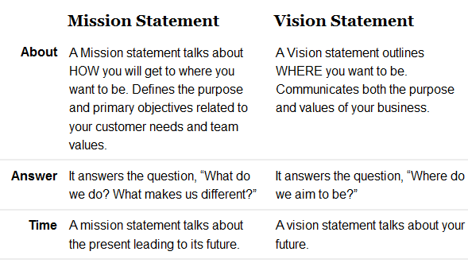
Comparison chart

Slide 19
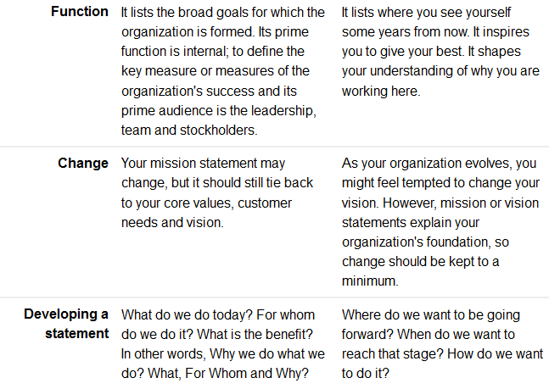
Comparison cont…

Slide 20
Comparison cont…

Slide 21
Which comes first?
For a new start up business, new program or plan to re-engineer your current services, the vision statement will be formulated first as it will guide the mission statement and the rest of the strategic plan.
For an established business where the mission is established, often the mission guides the vision statement and the rest of the strategic plan for the future.

Slide 22
Quiz -1 5%
Discuss organizational vision?

